Slide 1
Data Communication and Computer Networks

Slide 2
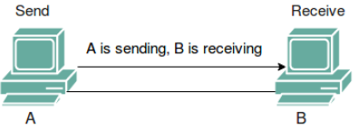
FLOW CONTROL
Flow control is a technique for assuring that a transmitting entity does not overwhelm a receiving entity with data.
110110101
The data are sent in a sequence of frames.
Each frame contains a portion of the data and some control information.
.

Slide 3
FLOW CONTROL
Receiving entity typically allocates a data buffer of some maximum length for a transfer.
In the absence of flow control, the receiver’s buffer may fill up and overflow while it is processing old data.
.

Slide 4
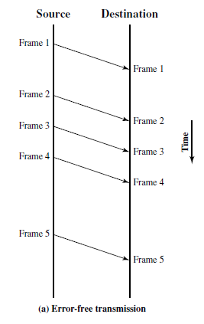
FLOW CONTROL
Mechanisms for flow control in the absence of errors.
Figure shows vertical-time sequence diagram.
Figure 7.1 Model of Frame Transmission
.

Slide 5
FLOW CONTROL
Transmission time : Time it taken for a station to emit all of the bits of a frame onto the medium.
Propagation time : Time taken for a bit to traverse the link between source and destination.
.

Slide 6
FLOW CONTROL
assumption
All frames that are transmitted are successfully received.
Frames arrive in the same order in which they are sent.
However, each transmitted frame suffers an arbitrary and variable amount of delay before reception.
.

Slide 7

Stop-and-Wait Flow Control
A source entity transmits a frame.
The source must wait until it receives the acknowledgment before sending the next frame.
The destination can thus stop the flow of data simply by with holding acknowledgment.
.

Slide 8
Sliding-Window Flow Control
The problem with stop and wait is that only one frame at a time can be in transit.
For very high data rates, for very long distances between sender and receiver, stop-and-wait flow control provides inefficient line utilization.
Efficiency can be greatly improved by allowing multiple frames to be in transit at the same time.
.

Slide 9
Sliding-Window Flow Control
Consider two stations A and B.
Station B allocates buffer space for W frames.
Thus, B can accept W frames, and A is allowed to send W frames without waiting for any acknowledgments.
.

Slide 10
Sliding-Window Flow Control
To keep track of which frames have been acknowledged, each is labeled with a sequence number.
B acknowledges a frame by sending an acknowledgment that includes the sequence number of the next frame expected.
.

Slide 11
Sliding-Window Flow Control
This scheme can also be used to acknowledge multiple frames.
B could receive frames 2, 3, and 4 but withhold acknowledgment until frame 4 has arrived.
By then returning an acknowledgment with sequence number 5, B acknowledges frames 2, 3, and 4 at one time.
.

Slide 12
Sliding-Window Flow Control
Sender maintains a list of sequence numbers that it is allowed to send. (sender window)
Receiver maintains a list of sequence numbers that it is prepared to receive. (Receiver window)
Each of these lists can be thought of as a window of frames.
The operation is referred to as sliding-window flow control.
.

Slide 13
Sliding-Window Flow Control
Because the sequence number to be used occupies a field in the frame, it is limited to a range of values.
For a 3-bit field, the sequence number can range from 0 to 7.
For a k-bit field the range of sequence numbers is 0 through
The maximum window size is
.

Slide 14
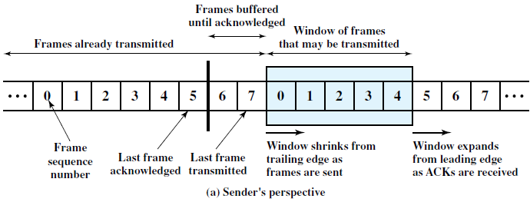
Sliding-Window Flow Control
Assumes the use of a 3-bit sequence number
The shaded rectangle indicates the frames that may be sent;
Here window size is 5.
.

Slide 15
Sliding-Window Flow Control
Each time a frame is sent, the shaded window shrinks;
each time an acknowledgment is received, the shaded window grows.
Frames between vertical bar and the shaded window have been sent but not yet acknowledged. Sender must buffer these frames in case they need to be retransmitted.
.

Slide 16
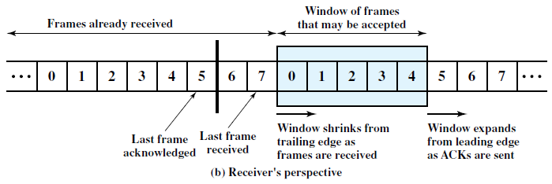
Sliding-Window Flow Control
.

Slide 17
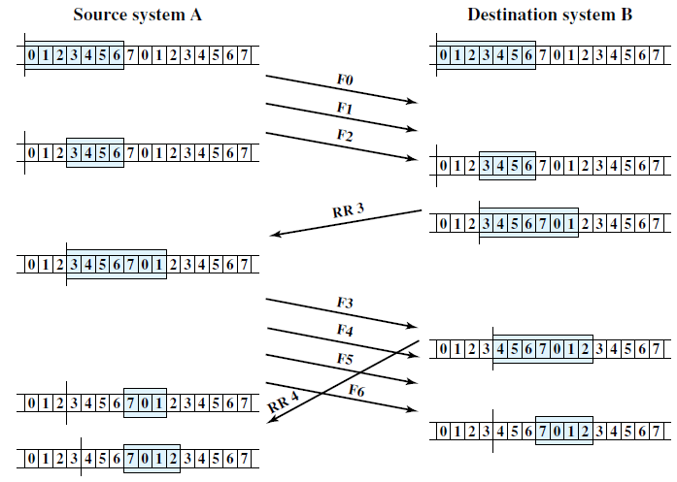
Sliding-Window Flow Control
Example assumes a 3-bit sequence number field and a maximum window size of seven frames.
.

Slide 18
Sliding-Window Flow Control
Receive Not Ready (RNR) message acknowledges former frames but forbids transfer of future frames.
RNR 5 means “received all frames up to number 4 but unable to accept any more at this time.”
At some subsequent point, the station must send a normal acknowledgment to reopen the window.
.

Slide 19
Sliding-Window Flow Control
So far discussed : transmission in one direction only.
If two stations exchange data, each needs to maintain two windows, one for transmit and one for receive.
To provide efficient support for this requirement, a feature known as piggybacking is typically provided.
Each data frame includes a field that holds the sequence number of that frame plus a field that holds the sequence number used for acknowledgment.
.

Slide 20
Sliding-Window Flow Control
if a station has data and acknowledgment to send, it sends both together in one frame.
if a station has an acknowledgment but no data to send, it sends a separate acknowledgment frame, such as RR or RNR.
If a station has data to send but no acknowledgment to send, it must repeat the last acknowledgment sequence number that it sent.
  This is because the data frame includes a field for the acknowledgment number, and some value must be put into that field.
  When a station receives a duplicate acknowledgment, it simply ignores it.
.

Slide 21
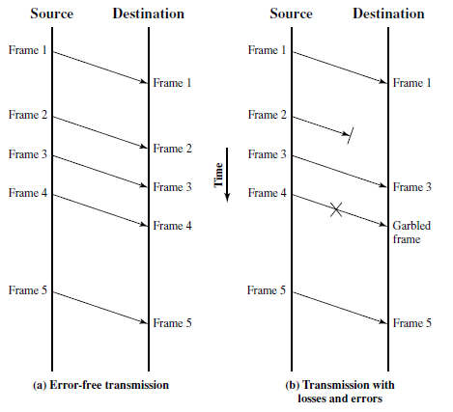
ERROR CONTROL
Error control refers to mechanisms to detect and correct errors that occur in the transmission of frames.
Figure 7.1 Model of Frame Transmission
.

Slide 22
ERROR CONTROL
The possibility of two types of errors:
Lost frame: A frame fails to arrive at the other side.
Damaged frame: Some of the bits are in error.
.

Slide 23
ERROR CONTROL
Most common techniques for error control are :
Error detection: discussed.
Positive acknowledgment: Destination returns a positive acknowledgment to successfully received, error-free frames.
Retransmission after timeout: Source retransmits a frame that has not been acknowledged after a predetermined amount of time.
Negative acknowledgment and retransmission: Destination returns a negative acknowledgment to frames in which an error is detected. Source retransmits such frames.
.

Slide 24
ERROR CONTROL
Collectively, these mechanisms are all referred to as automatic repeat request
(ARQ);
The effect of ARQ is to turn an unreliable data link into a reliable one.
Three versions of ARQ have been standardized:
Stop-and-wait ARQ
Go-back-N ARQ
Selective-reject ARQ
All of these forms are based on the use of the flow control techniques.
.

Slide 25
Stop-and-Wait ARQ
Stop-and-wait ARQ is based on the stop-and-wait flow control technique.
  Source station transmits a single frame and then must await an acknowledgment (ACK).
  No other data frames can be sent until the destination station’s reply arrives.
.

Slide 26
Stop-and-Wait ARQ
Two sorts of errors could occur.
First, the frame that arrives at the destination could be damaged.
Receiver detects this by error-detection technique & simply discards the frame.
The source station is equipped with a timer.
After a frame is transmitted, the source station waits for an acknowledgment.
If no acknowledgment is received by the time that the timer expires, then the same frame is sent again.
Requires that the transmitter maintain a copy of a transmitted frame until an acknowledgment is received for that frame.
.

Slide 27
Stop-and-Wait ARQ
The second sort of error is a damaged acknowledgment.
Station A sends a frame. Frame is received correctly by station B, which responds with an acknowledgment (ACK).
ACK is damaged in transit and is not recognizable by A, which will therefore time out and resend the same frame.
.

Slide 28
Stop-and-Wait ARQ
This duplicate frame arrives and is accepted by B.
B has therefore accepted two copies of the same frame as if they were separate.
To avoid this problem, frames are alternately labeled with 0 or 1, and positive acknowledgments are of the form ACK0 and ACK1.
ACK0 acknowledges receipt of a frame numbered 1 and indicates that the receiver is ready for a frame numbered 0.
.

Slide 29
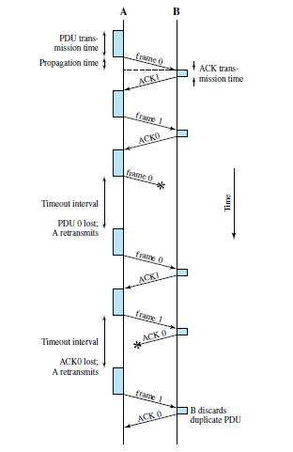
Stop-and-Wait ARQ
Frame transmitted by A is lost or damaged and therefore B does not return an ACK.
A times out and retransmits the frame.
A transmits a frame labeled 1 but the ACK0 for that frame is lost.
A times out and retransmits the same frame.
When B receives two frames in a row with the same label, it discards the second frame but sends back an ACK0 to each.
Figure 7.5 Stop-and-Wait ARQ
.

Slide 30
Go-Back-N ARQ
Based on sliding-window flow control that is most commonly used.
Station send a series of frames sequentially numbered modulo some maximum value.
.

Slide 31
Go-Back-N ARQ
no errors :
Destination will acknowledge incoming frames ( or piggybacked acknowledgment).
error
send a negative acknowledgment for that frame.
Destination station will discard that frame and all future incoming frames until the frame in error is correctly received.
Source station, when it receives a REJ, must retransmit the frame in error plus all succeeding frames that were transmitted in the interim.
.

Slide 32
Go-Back-N ARQ
Suppose that station A is sending frames to station B.
After each transmission, A sets an acknowledgment timer for the frame just transmitted.
Suppose that B has previously successfully received frame (i – 1) and A has just transmitted frame i.
The go-back-N technique takes into account the following contingencies:
.

Slide 33
Go-Back-N ARQ
Damaged frame. If the received frame is invalid (i.e., B detects an error ), B discards the frame. There are two subcases:
  Within a reasonable period of time, A subsequently sends
  frame ,B receives frame out of order and sends a
  REJ i. A must retransmit frame i and all subsequent frames.
  A does not soon send additional frames. B receives nothing and returns neither an RR nor a REJ. When A’s timer expires, it transmits an RR frame that includes a bit known as the P bit, which is set to 1. B interprets the RR frame with a P bit of 1 as a command that must be acknowledged by sending an RR indicating the next frame that it expects, which is frame i. When A receives the RR, it retransmits frame i. Alternatively, A could just retransmit frame i when its timer expires.
.

Slide 34
Go-Back-N ARQ
2. Damaged RR. There are two subcases:
B receives frame i and sends RR (i+1) which suffers an error in transit. Because acknowledgments are cumulative (e.g., RR 6 means that all frames through 5 are acknowledged), it may be that A will receive a subsequent RR to a subsequent frame and that it will arrive before the timer associated with frame i expires.
If A’s timer expires, it transmits an RR command as in Case 1b. It sets another timer, called the P-bit timer. If B fails to respond to the RR command, or if its response suffers an error in transit, then A’s P-bit timer will expire. At this point, A will try again by issuing a new RR command and restarting the P-bit timer. This procedure is tried for a number of iterations. If A fails to obtain an acknowledgment after some maximum number of attempts, it initiates a reset procedure.
3. Damaged REJ. If a REJ is lost, this is equivalent to Case 1b.
.

Slide 35
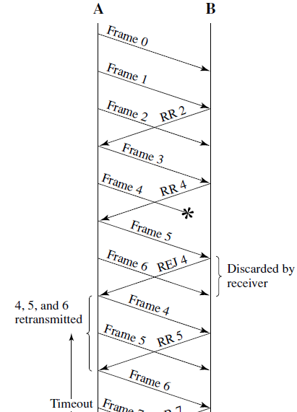
Go-Back-N ARQ
Here, frame 4 is damaged.
Frames 5 and 6 are received out of order and are discarded by B.
When frame 5 arrives, B immediately sends a REJ 4.
When the REJ to frame 4 is received, not only frame 4 but frames 5 and 6 must be retransmitted.
.

Slide 36
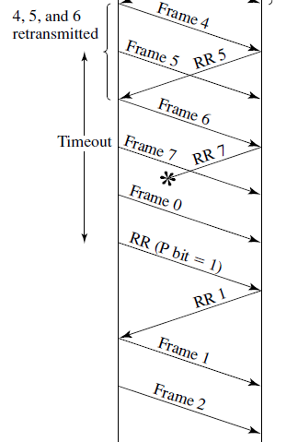
Go-Back-N ARQ
Figure 7.6a also shows an example of retransmission after timeout.
No acknowledgment is received for frame 5 within the timeout period, so A issues an RR to determine the status of B.
.

Slide 37
Go-Back-N ARQ
For a k-bit sequence number field, which provides a sequence number range of the maximum sender window size is limited to
Receiver window size is 1.
.

Slide 38
Go-Back-N ARQ
Assume a 3-bit sequence number (sequence number ).
Suppose a station sends frame 0 and gets back an RR 1 and
then sends frames 1, 2, 3, 4, 5, 6, 7, 0 and gets another RR 1.
This could mean that all eight frames were received correctly and the RR 1 is a cumulative acknowledgment.
It could also mean that all eight frames were damaged or lost in transit, and the receiving station is repeating its previous RR 1.
The problem is avoided if the maximum window size is limited to
.

Slide 39
Selective-Reject ARQ
With selective-reject ARQ, the only frames retransmitted are those that receive a
negative acknowledgment, in this case called SREJ, or those that time out.
.

Slide 40
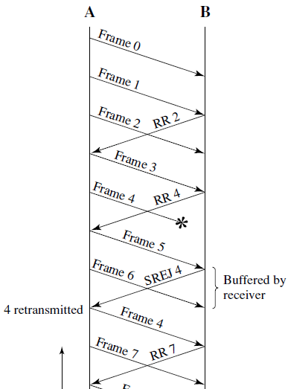
Selective-Reject ARQ
When frame 5 is received out of order, B sends a SREJ 4, indicating that frame 4 has not been received.
However, B continues to accept incoming frames and buffers them until a valid frame 4 is received.
At that point, B can place the frames in the proper order for delivery to higher-layer software.
.

Slide 41
Selective-Reject ARQ
Selective reject would appear to be more efficient than go-back-N, because it minimizes the amount of retransmission.
On the other hand, the receiver :
  must maintain a buffer large enough to save post-SREJ frames until the frame in error is retransmitted and
  must contain logic for reinserting that frame in the proper sequence.
The transmitter, too,
  requires more complex logic to be able to send a frame out of sequence.
.

Slide 42
Selective-Reject ARQ
Because of such complications, select-reject ARQ is much less widely used than go-back-N ARQ.
Selective reject is a useful choice for a satellite link because of the long propagation delay involved.
.

Slide 43
Selective-Reject ARQ
Window size limitation is more restrictive for selective-reject than for goback-N.
.

Slide 44
Selective-Reject ARQ
Consider the case of a 3-bit sequence number.
Allow a window size of seven, and consider the following scenario:
Station A sends frames 0 through 6 to station B.
Station B receives all seven frames and cumulatively acknowledges with RR 7.
Assume the RR 7 is lost.
A times out and retransmits frame 0.
B has already advanced its receive window to accept frames 7, 0, 1, 2, 3, 4, and 5.
Thus it assumes that frame 7 has been lost and that this is a new frame 0,
which it accepts.
.

Slide 45
Selective-Reject ARQ
To overcome the problem, the maximum window size should be no more than half the range of sequence numbers.
In general, for a k-bit sequence number field, which provides a sequence number range of 2^{k}, the maximum window size is limited to 2^{k-1}.
.

Slide 46
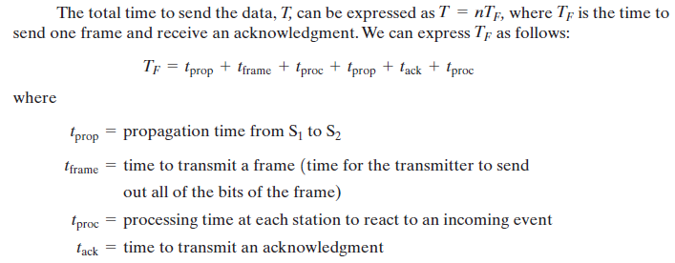
PERFORMANCE ISSUES
Stop-and-Wait Flow Control
Suppose that a long message is to be sent as a sequence of frames F₁,F₂,…….F_{n} from S₁ to S₂
.

Slide 47


PERFORMANCE ISSUES
Stop-and-Wait Flow Control
Assumptions:
Processing time is relatively negligible
Acknowledgment frame is very small compared to a data frame.
Then we can express the total time to send the data as
.

Slide 48


PERFORMANCE ISSUES
Stop-and-Wait Flow Control
Of that time, only is actually spent transmitting data and the rest is overhead.
The utilization, or efficiency, of the line is
Divide numerator and denominator by and substitute
.

Slide 49

PERFORMANCE ISSUES
Stop-and-Wait Flow Control
propagation time : distance d of the link divided by the velocity of propagation V.
propagation time =
For unguided transmission through air or V =
For guided transmission, V is approximately 0.67 times the speed of light
for optical fiber and copper media.
transmission time : length of the frame in bits, L, divided by the data rate R.
transmission time =
.

Slide 50
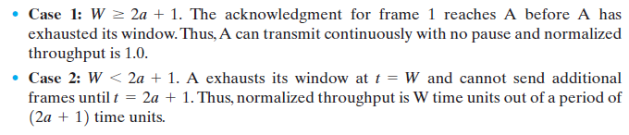

PERFORMANCE ISSUES
Error-Free Sliding-Window Flow Control
To evaluate performance, we need to consider two cases:
Therefore, express the utilization as
.

Slide 51
Example 1
A system uses the Stop-and-Wait ARQ Protocol. If each frame carries 1000 bits of data, how long does it take to send 1 million bits of data if the distance between the sender and receiver is 5000 Km and the propagation speed is 2 x 10⁸ m? Ignore transmission, waiting, and processing delays. Assume no data or control frame is lost or damaged.
  Propagation delay=d/V
d=5000km=5 x 10⁶ m, V= 2 x 10⁸ m
Propagation delay=5 x 10⁶ / 2 x 10⁸ =25ms
Nr of frame=1000000/1000=1000
Time delay for one successful frame delivery is 50ms(Ignore transmission, waiting, and processing delays. We assume no data or control frame is lost or damaged)
For 1000 frame, time delay=1000x50ms=50s
.

Slide 52
Example 2
Consider the use of 1000-bit frames on a 1-Mbps satellite channel with a 270-ms delay. What is the maximum link utilization for
  Stop-and-wait flow control?
  Continuous flow control with a window size of 7?
  Continuous flow control with a window size of 127?
  Continuous flow control with a window size of 255?
a= propagation Time/(L/R)
a=270 ×10⁻³/(10³/ 10⁶) = 270
U = 1/(1 + 2a) = 1/541 = 0.002
U = W/(1 + 2a) = 7/541 = 0.013
U = 127/541 = 0.23
U = 255/541 = 0.47
.

Slide 53
Example 3
Using 5-bit sequence numbers, what is the maximum size of the send and receive windows for each of the following protocols?
a. Stop-and-Wait ARQ
b. Go-Back-NARQ
c. Selective-Repeat ARQ
Stop-and-Wait ARQ=2⁰
Go-Back-NARQ=2⁵ -1
Selective-Repeat ARQ=2⁵⁻¹
.

Slide 54
Example 4
A sender sends a series of frame to the same destination using 5-bit sequence numbers. If the sequence number starts with 0, what is the sequence number after sending 100 frame?
A five-bit sequence number can create sequence numbers from 0 to 31
The sequence number in the Nth frame is (N mod 32)
101th frame has the sequence number (101 mod 32) or 5.
.

Slide 55
Example 5
A system uses the Go-back-N ARQ Protocol with a window size of 7. If each frame carries 1000 bits of data, how long does it take to send 1 million bits of data if the distance between the sender and receiver is 5000 Km and the propagation speed is 2 x 10⁸ m?
Ignore the overhead due to the header and trailer. (Assume transmission time of frame=1ms)
We need to send w=7 frame
1000000/7000=143 windows
Transmission time of window =7x1ms=7ms
Delay for 1 window
=t_{wframe}+2t_{prop} =7+50=57ms
Delay for 143 windows
=143x57ms=8.151s
.

Slide 56
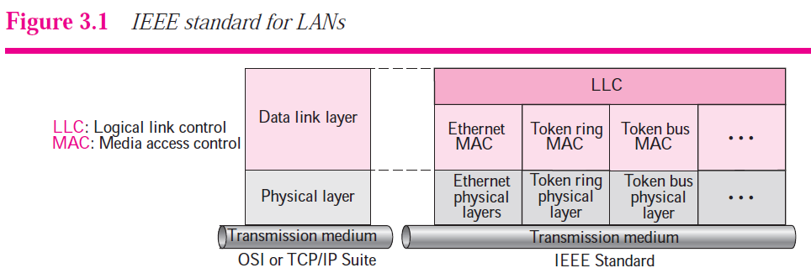
Ethernet Frame Format
IEEE Standards
In 1985, the Computer Society of the IEEE started a project, called Project 802, to set standards to enable intercommunication among equipment from a variety of manufacturers.
It is a way of specifying functions of the physical layer and the data link layer
of major LAN protocols.
.

Slide 57
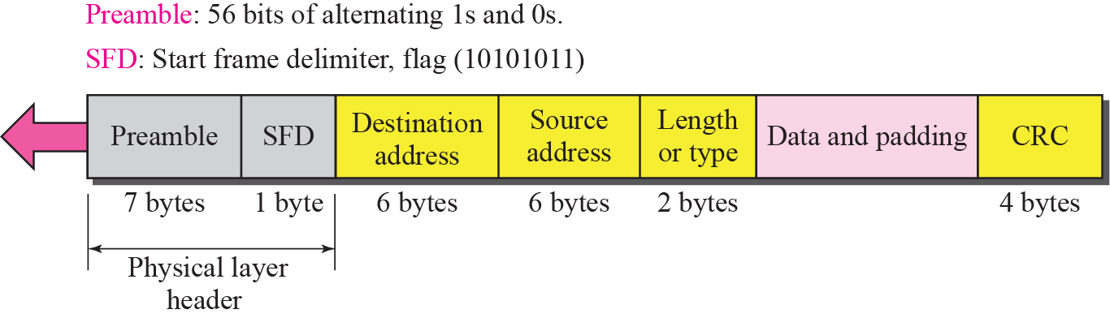
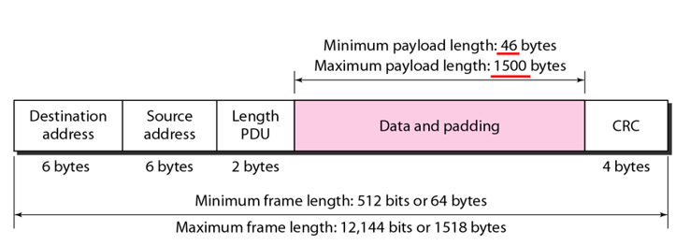
Ethernet Frame Format
.

Slide 58
Ethernet Frame Format
Preamble (7 bytes): 7 bytes (56 bits) of alternating 0^{s} and 1^{s} used to alert & synchronize receiver, sender clock rates.
SFD (1 byte): Start Frame Delimiter, flag (10101011): Signals the beginning of the frame. Last two bits 11 alert the receiver that the next field is the destination address.
Destination and source address: MAC address of source and destination.
Type/Length (2 Bytes): Length: Up to 1500 (max length)
  Type: Identify higher-layer data(0x0800 –IPv4 , 0x0806-ARP)
CRC(Cyclic Redundancy Check 4 Bytes): checked at receiver, if error is detected, the frame is simply dropped
Data: 46 to 1500 Bytes (if shorter: add pad)Why?
.

Slide 59
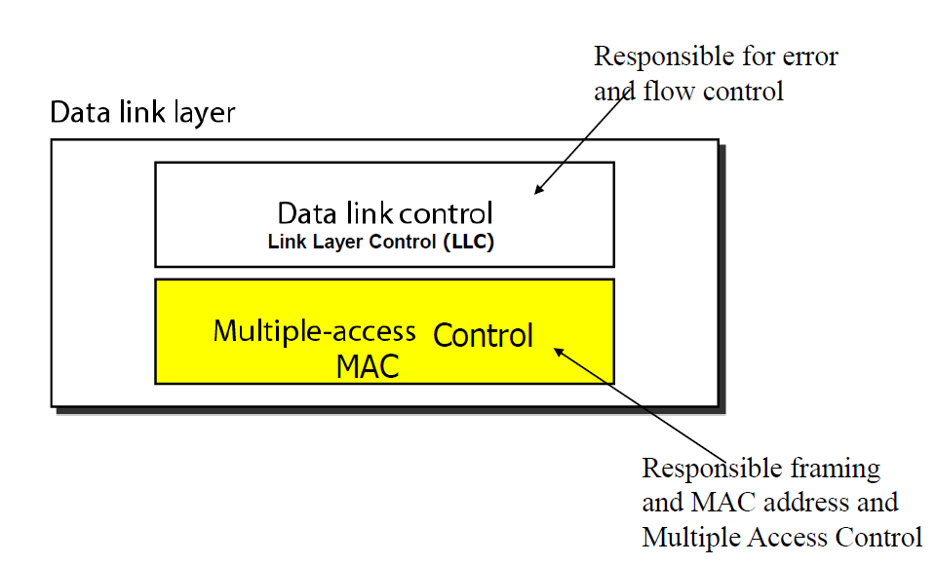
Access Control
When two or more nodes transmit at the same time, their frames will collide and the link bandwidth is wasted during collision.
MAC protocol : to coordinate the transmission of the active nodes.
.

Slide 60

Multiple Access Protocols: Main task is to minimize collisions in order to utilize the bandwidth by:
    Determining when a station can use the link (medium)
    what a station should do when the link is busy
    what the station should do when it is involved in collision
.

Slide 61
CSMA/CD
The IEEE 802.3 standard defines carrier sense multiple access with collision detection (CSMA/CD) as the access method for traditional Ethernet.
To minimize the chance of collision and, the CSMA method was developed. The chance of collision can be reduced if a station senses the medium before trying to use it.
Carrier sense multiple access (CSMA) requires that each station first listen to the medium before sending.
CSMA can reduce the possibility of collision, but it cannot eliminate it.
.

Slide 62
CSMA/CD
The possibility of collision still exists because of propagation delay; when a station sends a frame, it still takes time (although very short) for the first bit to reach every station and for every station to sense it.
In other words, a station may sense the medium and find it idle, only because the first bit sent by another station has not yet been received.
.

Slide 63
CSMA/CD
Carrier sense multiple access with collision detection (CSMA/CD) augments the algorithm to handle the collision.
In this method, a station monitors the medium after it sends a frame to see if the transmission was successful.
If so, the station is finished. If, however, there is a collision, the frame is sent again.
.

Slide 64
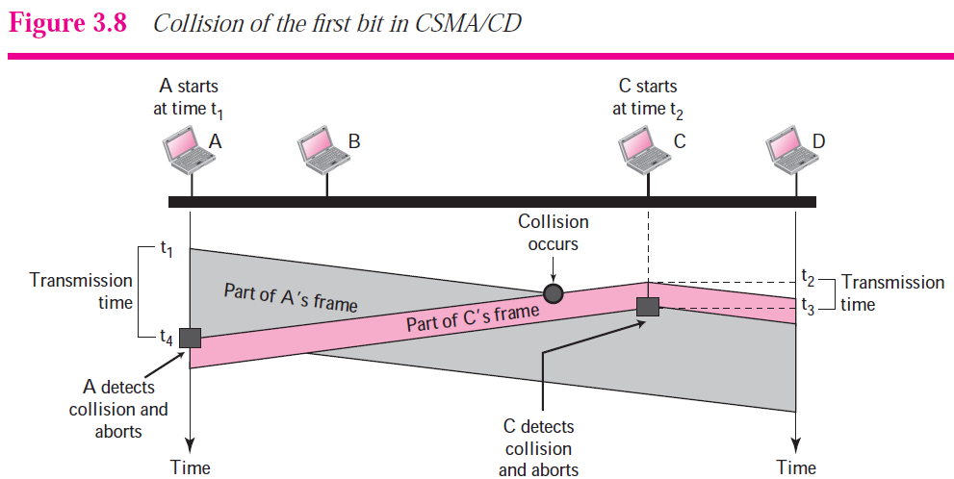
In Figure, stations A and C are involved in the collision.
At time t1, station A has started sending the bits of its frame. At time t2, station C has not yet sensed the first bit sent by A. Station C starts sending the bits in its frame, which propagate both to the left and to the right.
The collision occurs sometime after time t2. Station C detects a collision at time t3 when it receives the first bit of A’s frame. Station C immediately aborts transmission.
Station A detects collision at time t4 when it receives the first bit of C’s frame; it also immediately aborts transmission.
A transmits for the duration t4− t1; C transmits for the duration t3− t2.
.

Slide 65

.

Slide 66

Energy level during transmission, idleness, or collision
level of energy in a channel can be: zero, normal, and abnormal.
At the zero level, the channel is idle.
Normal level : station has successfully captured the channel and is sending its frame.
abnormal level : there is a collision and the level of the energy is twice the normal level.
A station that has a frame to send or is sending a frame needs to monitor the energy level to determine if the channel is idle, busy, or in collision mode.
.

Slide 67
end
.

